Slide 1


Navyug Vidyabhavan Trust
C. K. Pithawala College of Engg. & Tech.
Web Development
Computer Engineering Department
First Presentation
Internship / Project
(3180701)
BE IV, Sem VIII
Presented By
Yukti Patel
(180090107049)
Faculty Guide
Prof. Unnati Shah

Slide 2
Table of Contents
Company Brief
Company Contact Details
Technology Stack
Work of Profile
Type of Engagement
Weekly Diary
Documents

Slide 3
Company Brief

Slide 4
L&T MHI Power Generators Pvt. Ltd.
Larsen & Toubro Limited (L&T) is a technology-driven engineering and construction organization, and one of the largest companies in India's private sector. It has additional interests in manufacturing, services and Information Technology.
With factories and offices located around the country, further supplemented by a comprehensive marketing and distribution network, L&T enjoys an image and equity in virtually every district of India.
The Company has an international presence, with a global spread of offices and joint ventures with world leaders. L&T's large technology base and pool of experienced personnel enable it to offer integrated services in world markets.

Slide 5
L&T MHI Power Generators Pvt. Ltd.
L&T BUSINESS PORTFOLIO
The L&T Group comprises six operating Divisions Engineering & Construction Projects
Construction
Heavy Engineering
Electrical & Electronics
Information Technology
Machinery & Industrial Projects

Slide 6
Company Contact Details
Address: Hazira Manufacturing Complex (West),Gate No. -8, Surat Hazira Road, P.O. Bhatha, Surat - 394 510
Call Us: (0261)2808100
Email: infodesk@larsentoubro.com
Website: https://www.lmtg.in
Resource Person Name/Leader: Mr. Kushal Ariwala
Resource Person Contact: 7878364763
Resource Person Email: kushal.ariwala@lntmhipower.com

Slide 7
Technology Stack

Slide 8
SharePoint
Microsoft SharePoint is
Cloud-based service
Helps organization to share and manage contents
Seamlessly collaborate across the organization
Built in Intranet sites
create pages, document libraries, and lists.
Add web parts to customize your content.
Catch up on news on-the-go with the mobile app

Slide 9
InfoPath
Microsoft InfoPath is a software application for designing, distributing, filling and submitting electronic forms containing structured data. Microsoft initially released InfoPath as part of the Microsoft Office 2003 family.
The product features a WYSIWYG form designer in which the various controls (e.g. text box, radio button, checkbox) are bound to data, represented separately as a hierarchical tree view of folders and data fields.

Slide 10
Lansweeper
Lansweeper offers a variety of methods to scan your network, most of which can be configured in the Scanning\Scanning Targets section of the web console. You can use one or more of these methods for scanning, depending on your personal needs and preferences.
Lansweeper allows you to scan networks ranging from just a few to hundreds of thousands of assets
A Lansweeper installation consists of 3 components. A default setup contains one database, one web console and one scanning service, all located on the same machine.
Depending on the size and complexity of your network you can choose to spread out your components and/or add additional scanning services across several machines.

Slide 11
Visual Basic
Visual Basic is a third-generation event-driven programming language. It evolved from the earlier DOS version called BASIC.
BASIC means Beginners' All-purpose Symbolic Instruction Code.
Visual Basic is a user-friendly programming language designed for beginners, and it enables anyone to develop GUI window applications easily.
Like all other .NET languages, VB.NET has complete support for object-oriented concepts. Everything in VB.NET is an object, including all of the primitive types (Short, Integer, Long, String, Boolean, etc.) and user-defined types, events, and even assemblies. All objects inherits from the base class Object.
VB.NET is implemented by Microsoft's .NET framework. Therefore, it has full access to all the libraries in the .Net Framework. It's also possible to run VB.NET programs on Mono, the open-source alternative to .NET, not only under Windows, but even Linux or Mac OSX.

Slide 12
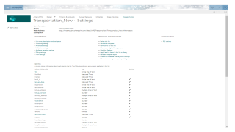
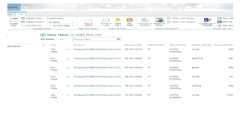
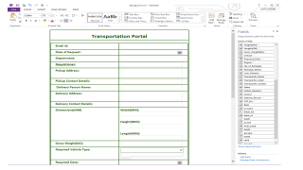
Creating list in SharePoint for Transportation Portal
1. Creating list 2.Adding details using quick edit
3.Migrating Sharepoint List
To infopath form

Slide 13
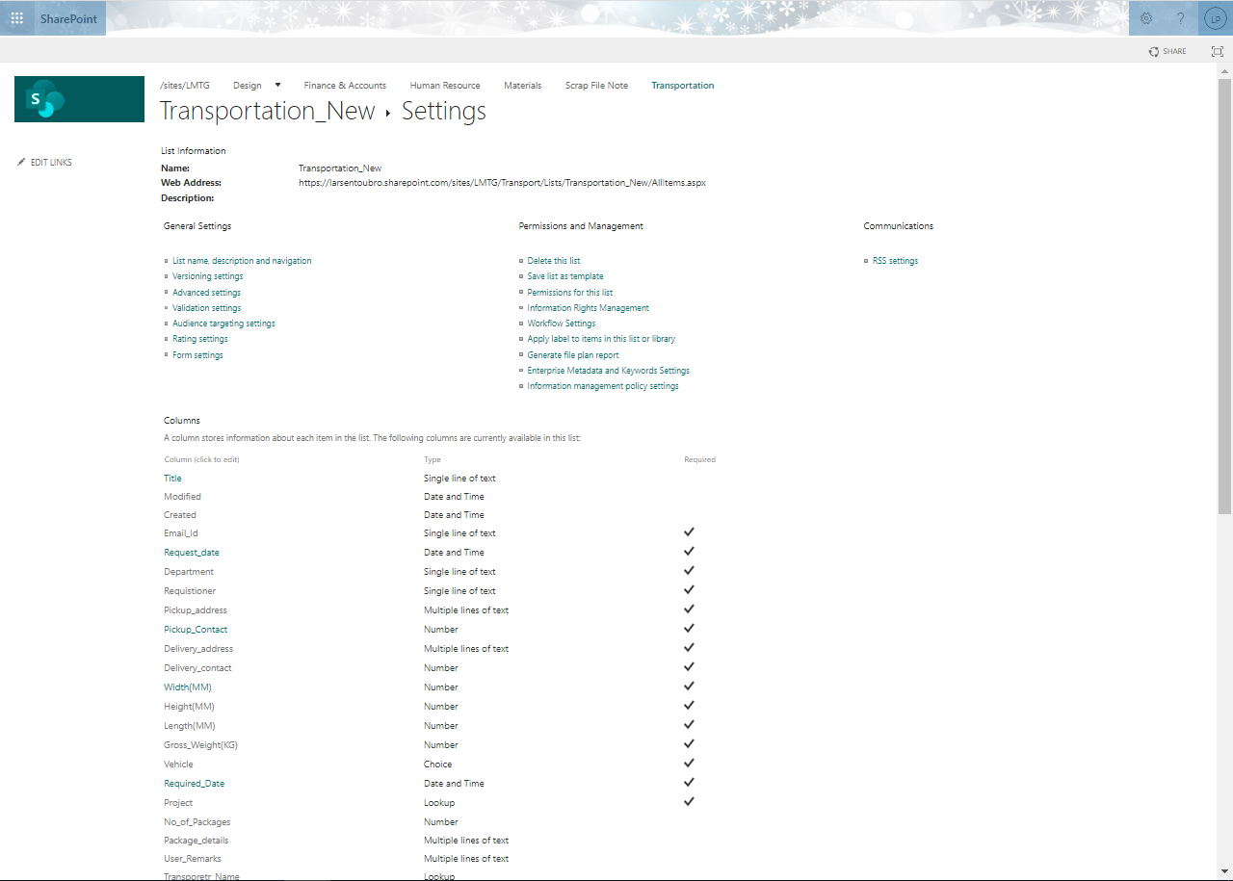

Slide 14
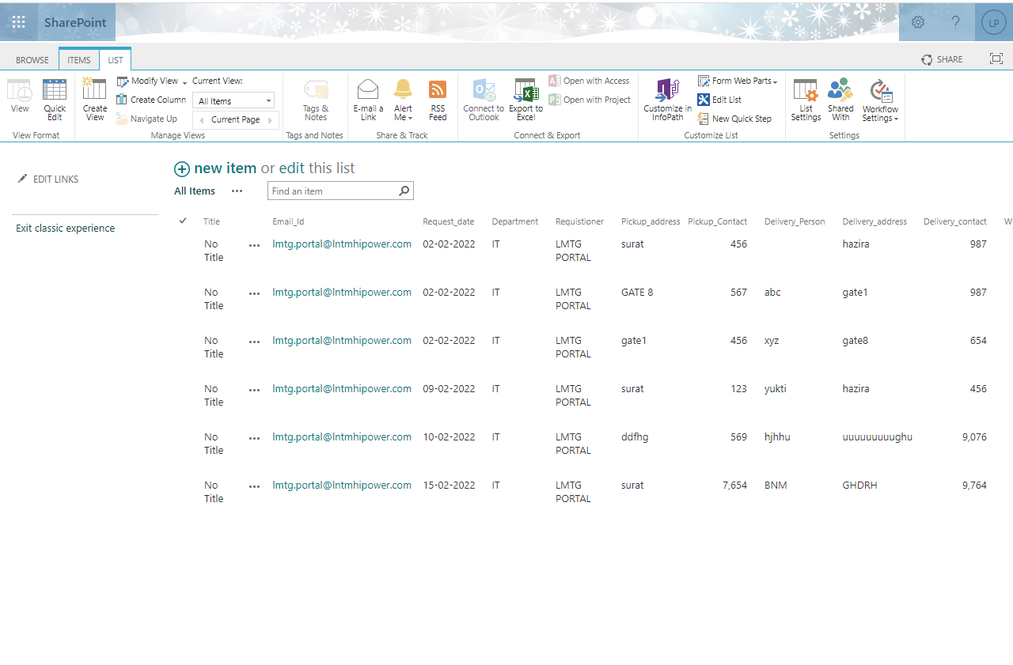

Slide 15
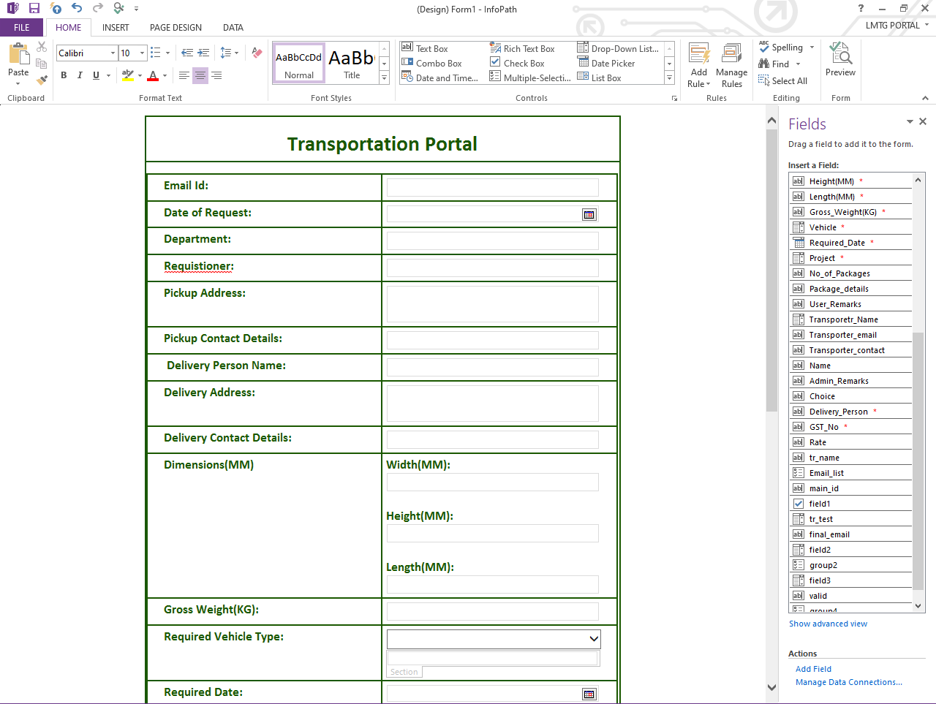

Slide 16
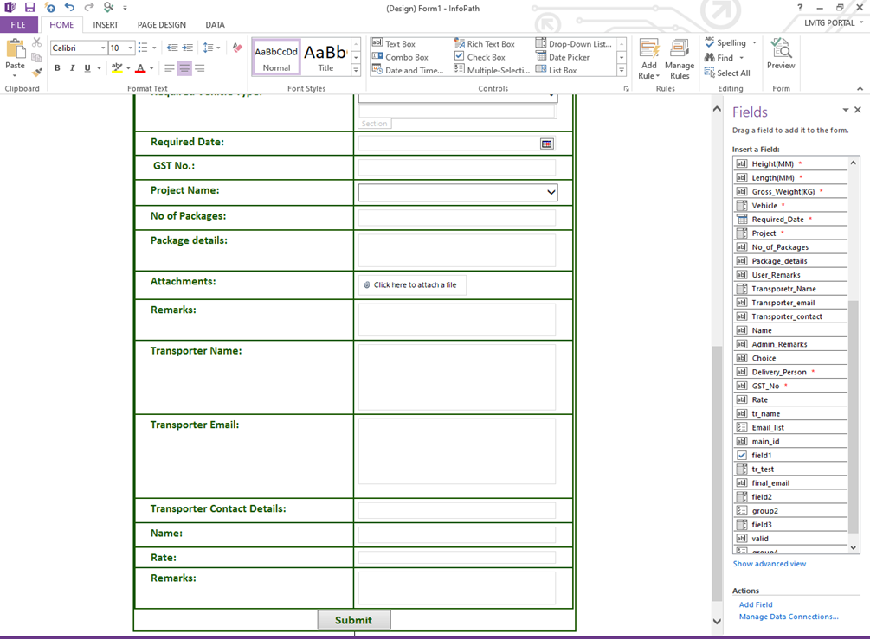

Slide 17
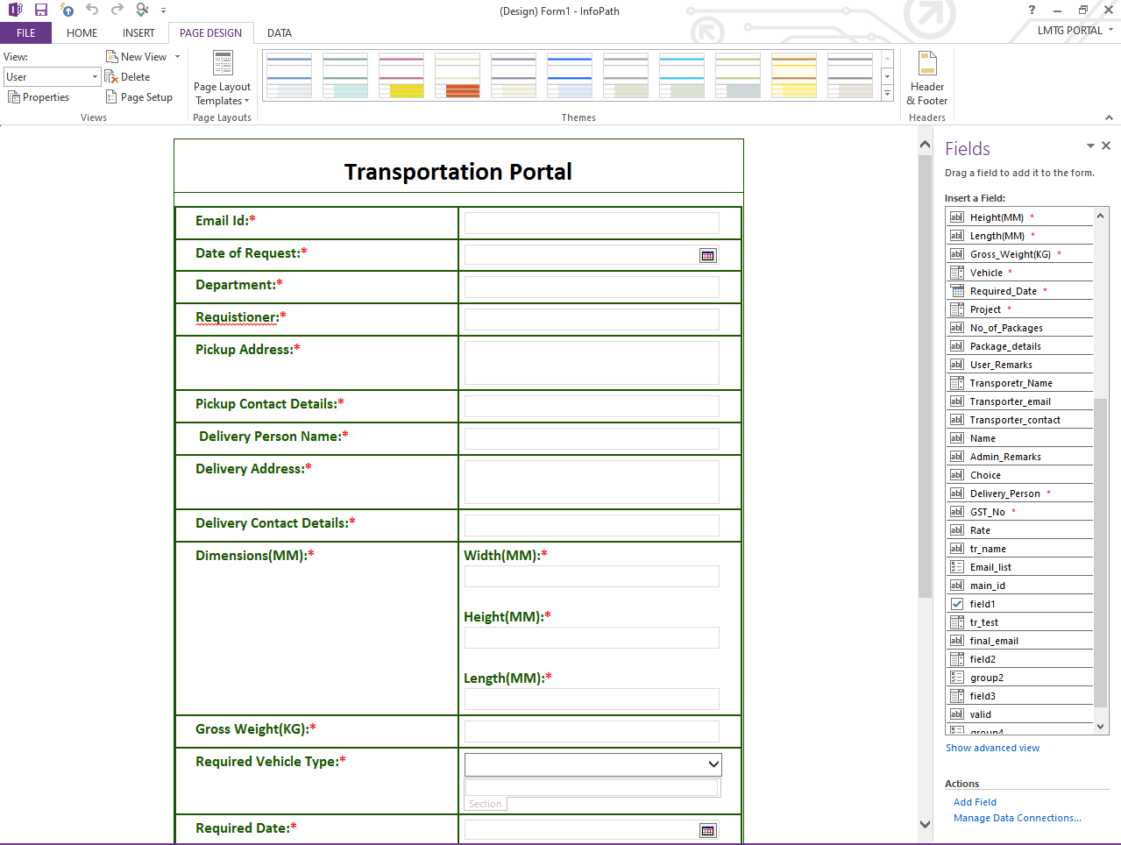

Slide 18
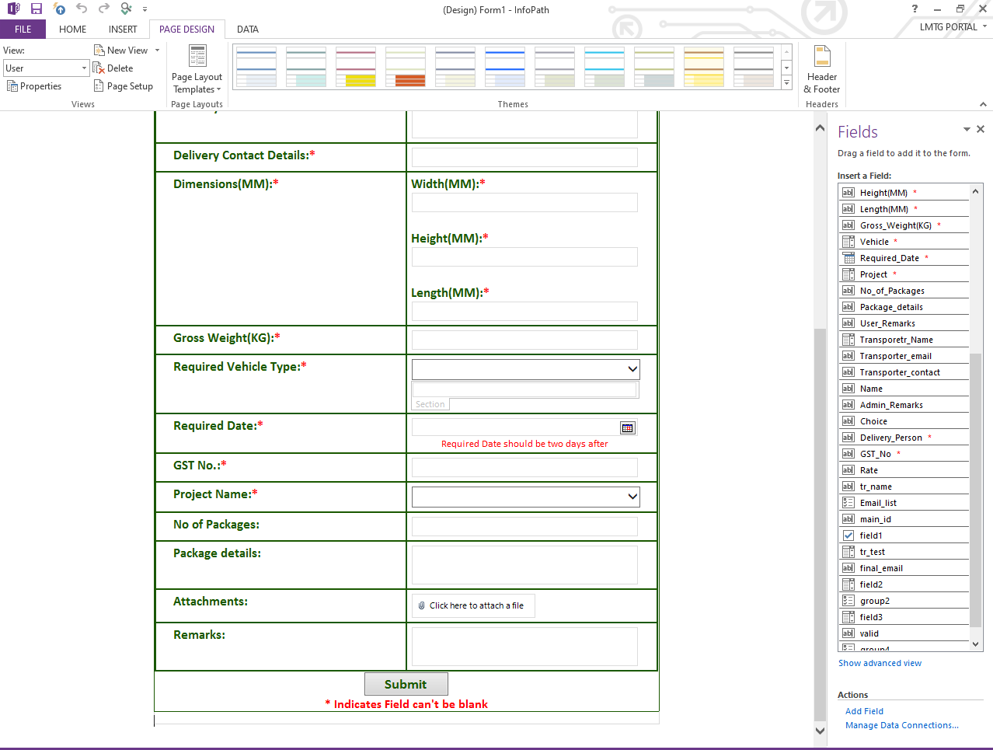

Slide 19
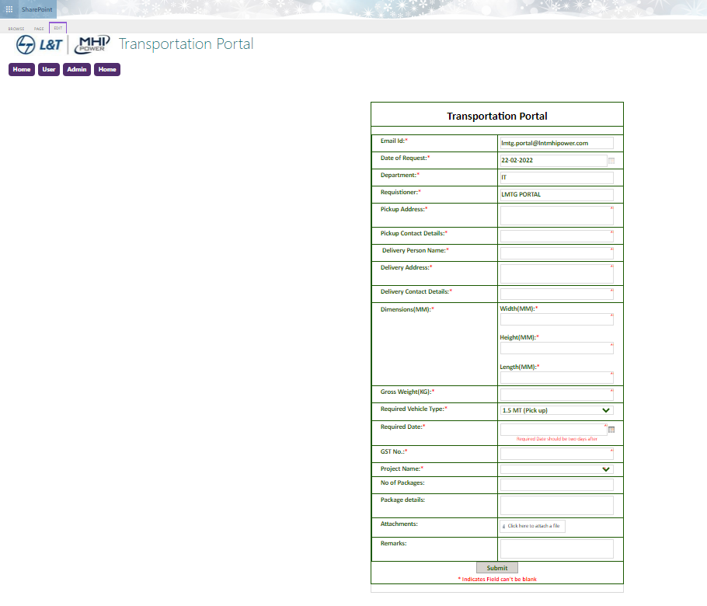
Creating Pages in SharePoint
User Page

Slide 20
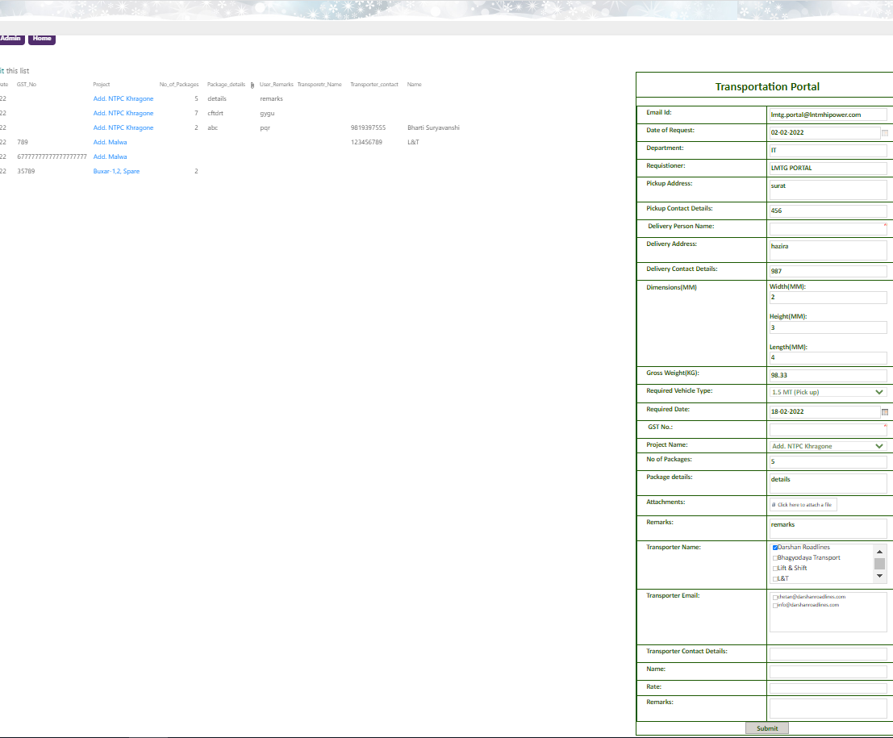
Creating Pages in SharePoint
Admin Page

Slide 21
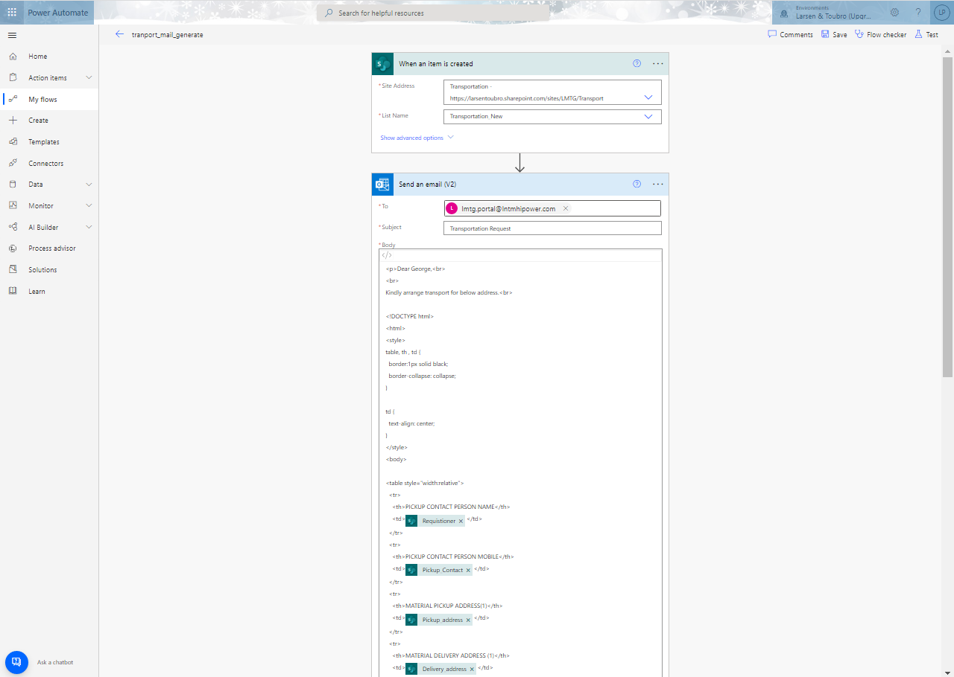
WorkFlow
Format

Slide 22
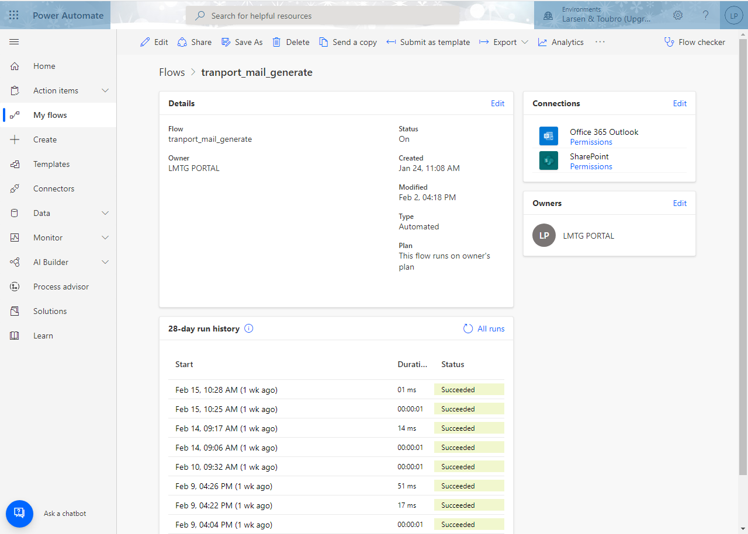
WorkFlow
Successful running of flow when form is submitted by user.

Slide 23
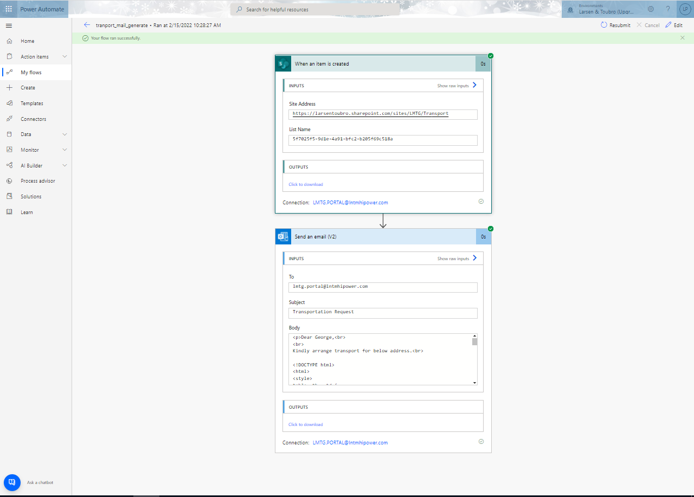
WorkFlow
Successful Flow Run

Slide 24
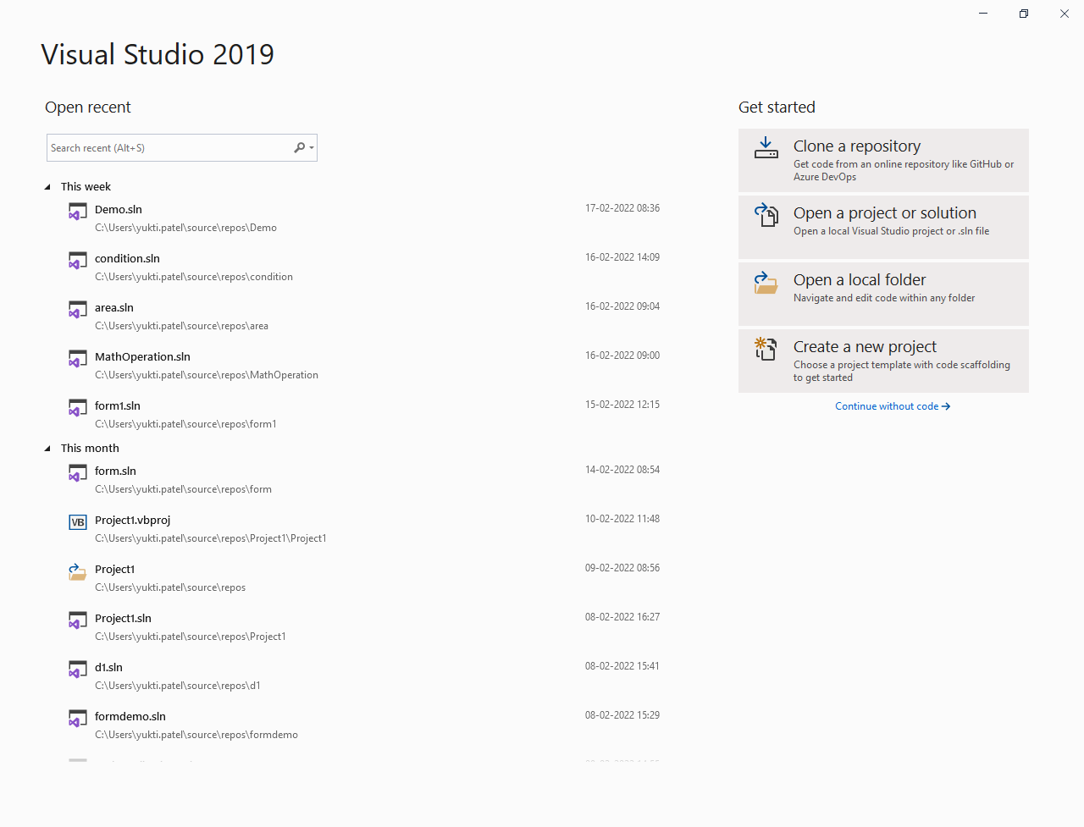
Visual Basic
Creating New Form

Slide 25
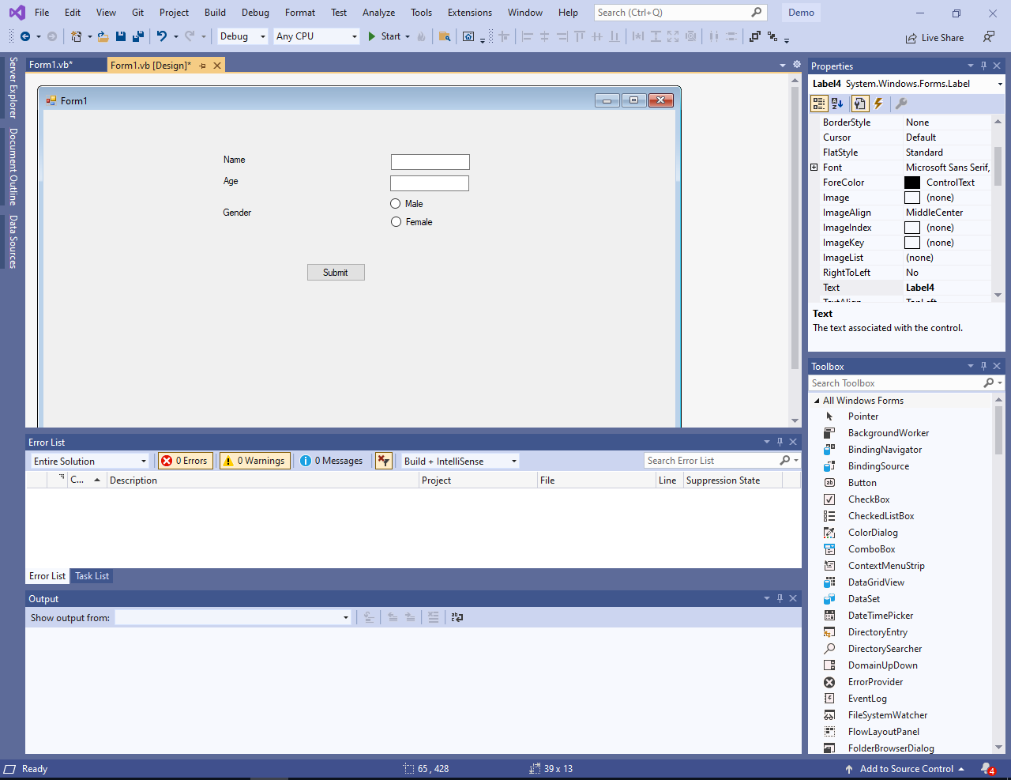
Visual Basic
Simple Form

Slide 26
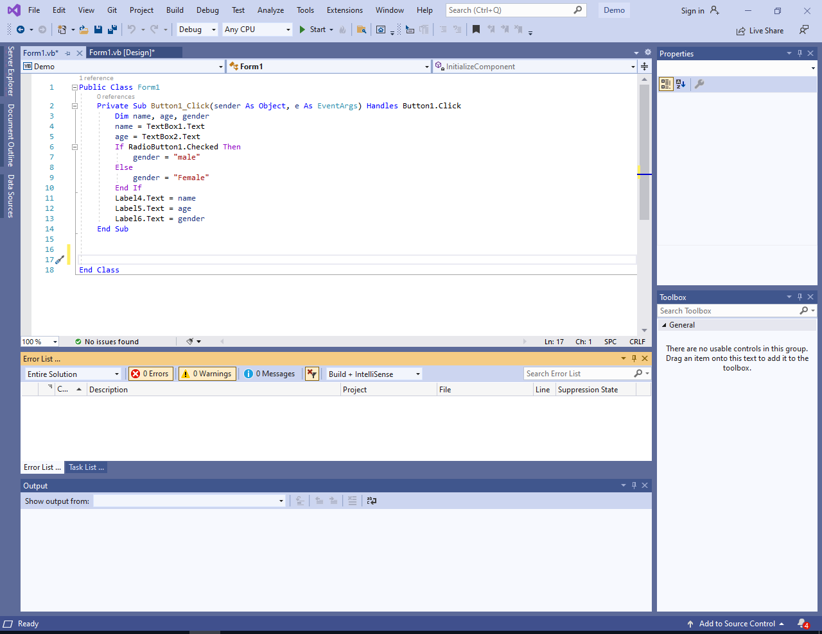
Visual Basic
Code

Slide 27
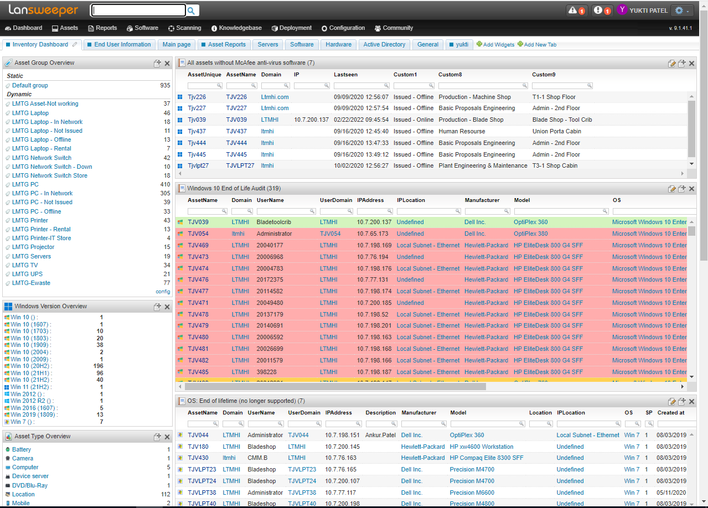
Lansweeper
Home Page

Slide 28
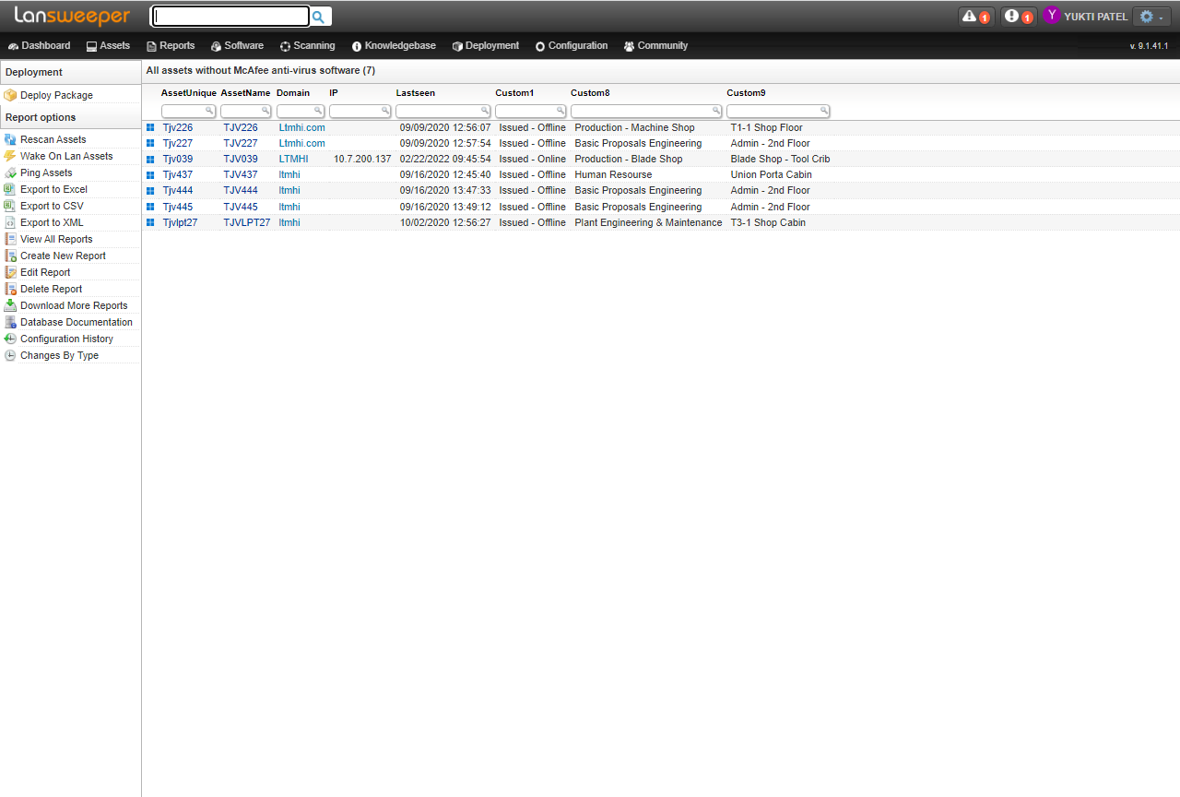
Lansweeper
Report

Slide 29
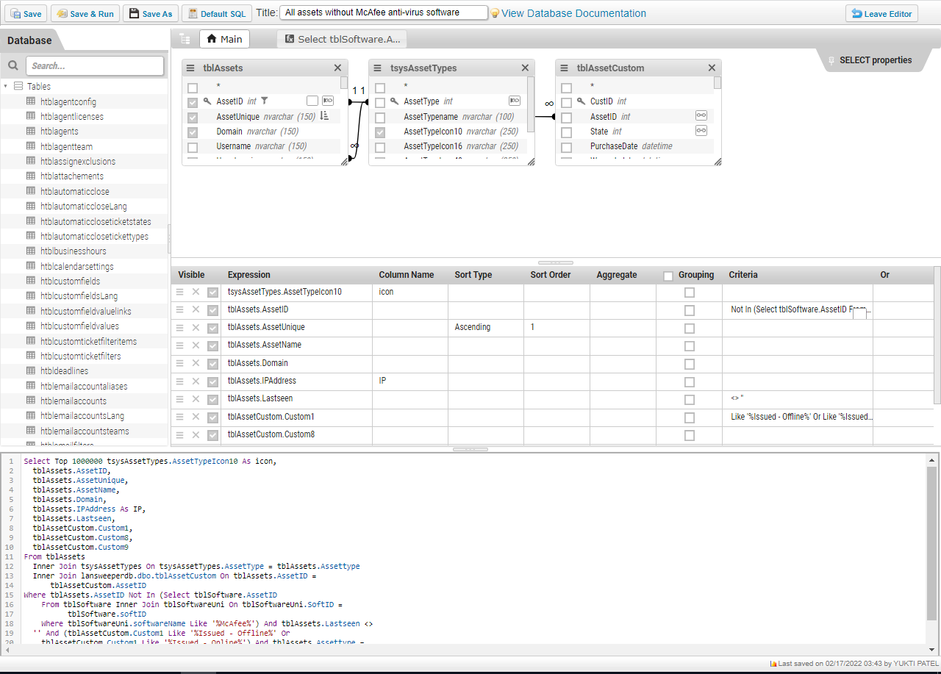
Lansweeper
Report Editing

Slide 30
Type of Engagement

Slide 31
Type of Engagement
Offline
6 days a week
8 hours per day

Slide 32
Weekly Dairy

Slide 33
Week -1
Date | day | Work Done | hrs
10/1 | Mon | SharePoint basic functionality like creating list, columns, | 4
11/1 | Tue | SharePoint modify existing columns, creating different views, quick editing, InfoPath basic export SharePoint list to InfoPath form, adding submit button, publish and review form | 8
12/1 | Wed | InfoPath features (form creation, validation) fetch SharePoint data in InfoPath, create new list-transportation and add validations in InfoPath form | 8
13/1 | Thru | Grey out, form creation, multiple values, date validation, disable control (read only), manage rule functionality to add multiple rules to same field | 8
14/1 | Fri | Holiday | 0
15/1 | Sat | Holiday | 0

Slide 34
Week 2
Date | Day | Work Done | Hrs
17/1 | Mon | Autofill username in InfoPath | 8
18/1 | Tue | Validations on form | 8
19/1 | Wed | New project(transport), attachments validation, only one attachment is allowed in one form, we can add multiple attachments in Form, but it will only duplicate data multiple times all attachments store same data | 8
20/1 | Thru | Validation in new form, learn about hyperlink in form, we can add multiple hyperlinks in form, it only stores address of site, we have to insert data dynamically | 8
21/1 | Fri | Add Hyperlink in form (Site issue), how to add workflow, types of options available in workflow | 8
22/1 | Sat | Documentation about SharePoint | 4

Slide 35
Week 3
Date | Day | Work Done | Hrs
24/1 | Mon | Workflow (generate email in table format when new entry is made), cloud storage, add html table to get data in table format in workflow when mail is sent when user enter submit button | 8
25/1 | Tue | Data connections-while making new data connection always remember to uncheck “do not save encrypted pages to disk” in internet explorer by clicking settings->internet options->advance, field validations in transportation- auto fetch name who is filling form from his email id, auto fetch email id which is used to fill form, department of person who is filling form | 8
26/1 | Wed | Holiday | 0
27/1 | Thru | Create flow, add new page for transportation, meeting with George | 8
28/1 | Fri | Modifications in transportation form- create section and add text box in it and enable textbox when other is selected in dropdown menu in types of vehicle option, create master table and fetch it into transportation table using lookup | 8
29/1 | Sat | Meeting – change some requirements- add remarks, add attachment, change name of fields, display text for user information, make all fields compulsory, modify, create new list-project for fetching data into form | 4

Slide 36
Week 4
Date | Day | Work Done | Hrs
31/1 | Mon | Lookup, select 1 column and auto fetch values in other columns | 8
1/2 | Tue | Create new list-new transportation, create new pages-admin &user, add all validations and make connections. | 8
2/2 | Wed | Create CSS file – design for portal design, create new pages-reports & my request, add CSS file for removing all contents of page so that user does not have any control or can make changes in portal. Modify dataflow. Make connections in admin list connect list with form. | 8
3/2 | Thru | Modification in telephone directory- changing email, study of DNS, DHCP, Router, Active directory, SQL, MPLS | 8
4/2 | Fri | DNS, MPLS, Router, API, Active Directory, Http, add gst no field in transportation form | 8
5/2 | Sat | DNS, MPLS, Router, API, Active Directory, Http, add gst no field in transportation form | 4

Slide 37
Week 5
Date | Day | Work Done | Hrs
7/2 | Mon | Holiday | 0
8/2 | Tue | Home page formatting- button should not change colour, create simple form in vb | 8
9/2 | Wed | Meeting with George- modify some requirements in existing form and make a separate workflow to send email to selected transporter email. | 8
10/2 | Thru | Simple form in vb to add two numbers, change background color of form by coding and properties | 8
11/2 | Fri | Holiday | 0
12/2 | Sat | Holiday | 0

Slide 38
Week 6
Day | Date | Wok Done | Hrs
14/2 | Mon | Vb- intro, building UI, enhancing UI, writing code, working with controls, list box & combo box, dealing with data, variables & constants, creating arrays | 8
15/2 | Tue | Math operations in vb- draw triangle, find area of triangle, find BMI, string manipulation using +, & signs, string manipulation using built-in fun-Len, right, left, mid, trim (Ltrim, Rtrim), InsStr function, UCase(converts all char to upper case) , LCase, Asc, Chr
16/2 | Wed | Vb functions, creating form
17/2 | Thru | Lansweeper
18/2 | Fri | Lansweeper
19/2 | Sat | Lansweper, Canteen Management System ppt

Slide 39
Documents

Slide 40
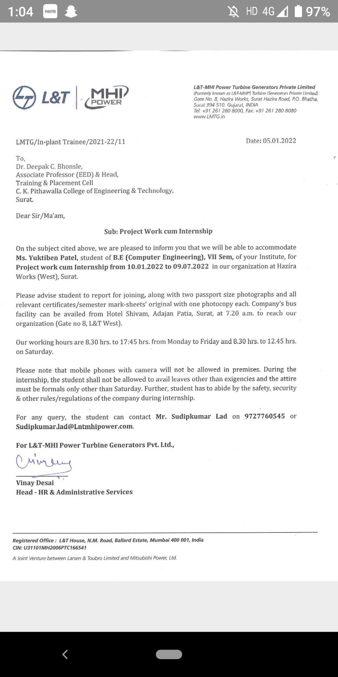
Offer Letter

Slide 41
Thank You

